Slide 1

Deepfake Detection
Statistical Machine Learning
Rutuja Jadhav
Shine Lin
Zachary Badger-Markey
4/22/2020

Slide 2
Table of Contents
1 . Problem description and background
2. Problem formulation and algorithm
3. Experimental results and analysis
4. Discussion and insight about our project.

Slide 3
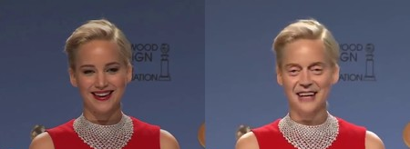
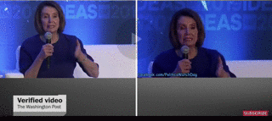
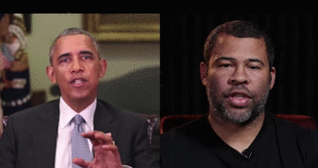
Problem background
What are DeepFakes?
DeepFake is composed from Deep Learning and Fake and means taking one person from an image or video and replacing with someone else likeness using technology such as Deep Artificial Neural Networks [1].
Why is this important?
.The phenomenon rapidly invades the film industry and threatens to compromise news agencies. Large digital companies, including content providers and social platforms are in the frontrun of fighting DeepFakes.
DeepFakes may affect the quality of public discourse and the safeguarding of human rights—especially given that DeepFakes may be used maliciously as a source of misinformation, manipulation, harassment, and persuasion.

Slide 4
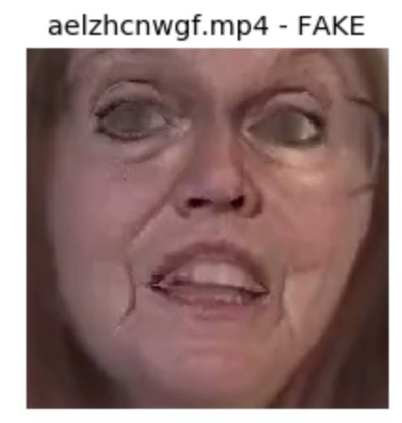
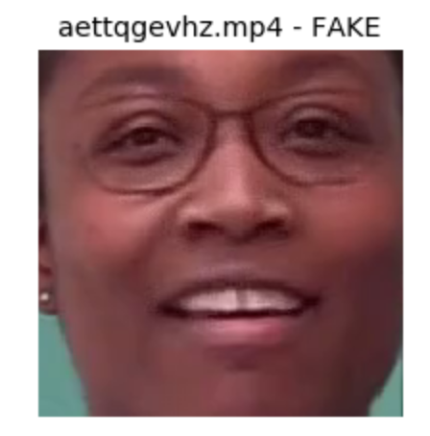
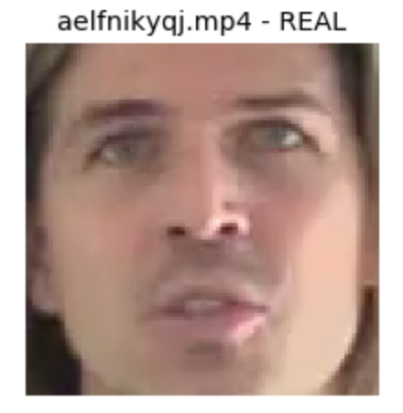
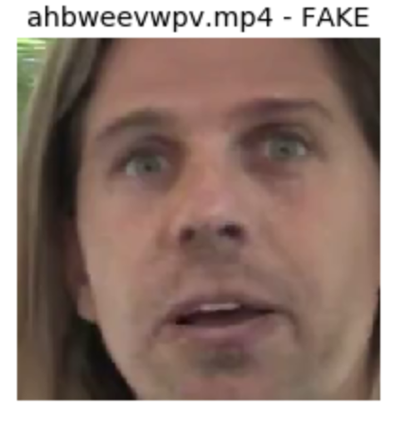
1. Problem description
The DeepFake Detection Challenge
AWS, Facebook, Microsoft, the Partnership on AI’s Media Integrity Steering Committee, and academics have come together to build the Deepfake Detection Challenge. While we don’t think we will be able to finish within the competition (it closes in 15 days), we do hope to add to its body of work.
470GB dataset consisting of original and fake videos. [3]
Our goal was to experiment with different methods and build upon them to help detect DeepFakes and manipulated media and to learn more about this subject area.
Detect fake vs real images on image dataset subsampled

Slide 5
2. Problem formulation and algorithm
Our Dataset
Only images 150x150, randomly selected from the greater dataset. Total size - 768 MB.
It turns out there were many more fake images than real images in the data set - 64,773 fake compared to 13,388 real. To compensate for this, we simply chose a subset of the fake images to have the same number of samples.
We did a 90/10 split of the data. This left us with 12,130 real and 12,130 fake training samples. We similarly had 1258 real and 1258 fake testing samples.
Our Models
Machine learning (methods like decision-tree, boosting) focusing on some of the features, layer 1.
Deep learning approaches. - CNN and autoencoders - deeper features.
General approach - bagging. Combines different models and takes the average of them.

Slide 6
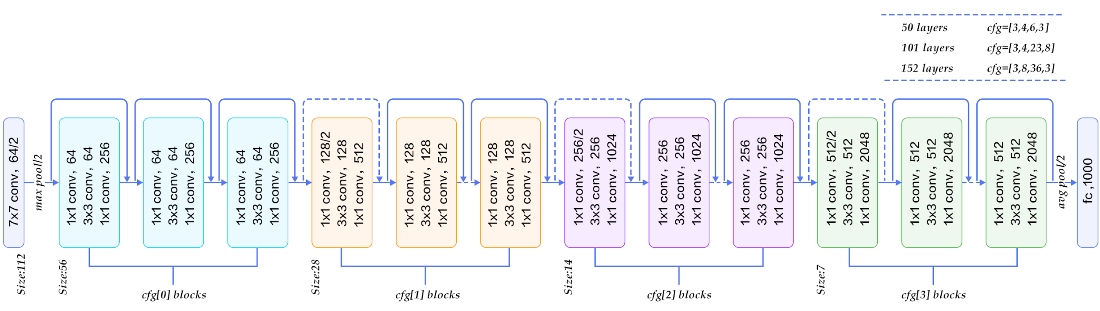
3. Experimental results and analysis
Baseline
InceptionNet (CNN) accuracy: 63%. Strong architecture to know the baseline accuracy without any preprocessing, using only the images.

Slide 7
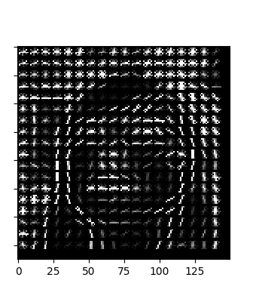
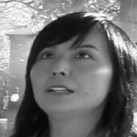
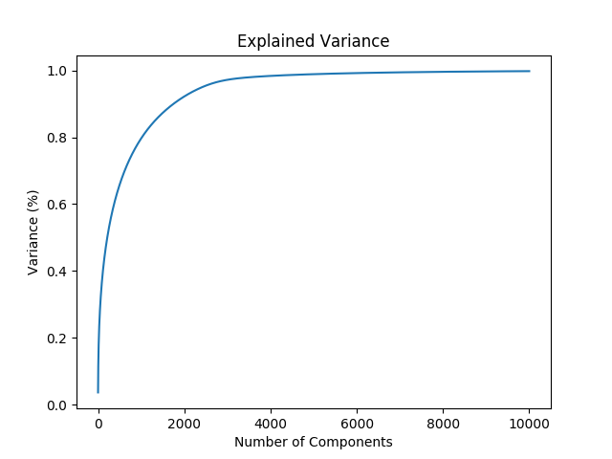
3. Machine learning approaches
Data preprocess:
Grayify - change into gray image
Hogify - extract the edge features
Normalize - normalize the data from 0 to 1
PCA - dimension reduction. Original dimensions are 20,000, around 2,000 dimensions can predict 90% of the information
Notes:
Image after transform

Slide 8
3. Machine learning approaches
ML models and their performance
Stochastic gradient - go to local or global minimum - 0.57 accuracy (0.70 on unbalanced dataset)
Decision Tree - started with this, then used the following to improve the performance:
Adaboost - 0.57 accuracy (0.80 on unbalanced dataset)
Gradient boosting - 0.59 accuracy (0.80 on unbalanced dataset)
Notes:
Numbers for accuracy and f1 and AUC

Slide 9
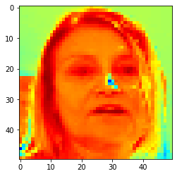
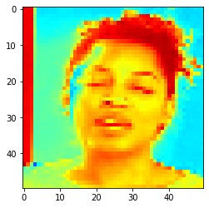
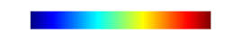
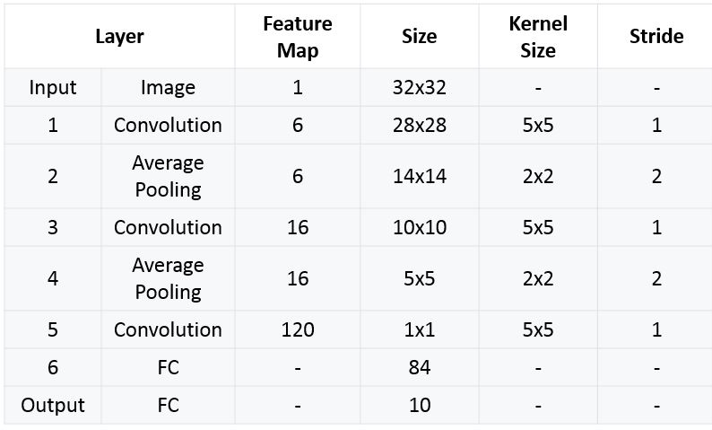
3. Deep learning approach - facial gradient CNN
Preprocess frames to extract facial gradients through colormap COLORMAP_JET
Attention to sharp gradients
Pass through Convolutional Neural Network
(Trainable parameters: 56,320)
Real face
Fake face
Accuracy:0.95 F1:0.87
Notes:
Intuition behind this, for fake faces the gradients are less uniform than for the real faces.
Colomap_Jet format. Looking for sharp gradients (changes to pixels values)
CNN attention is on the sharp gradients.
THis is all preprocessing
F1: focused on false positive/ false negatives

Slide 10
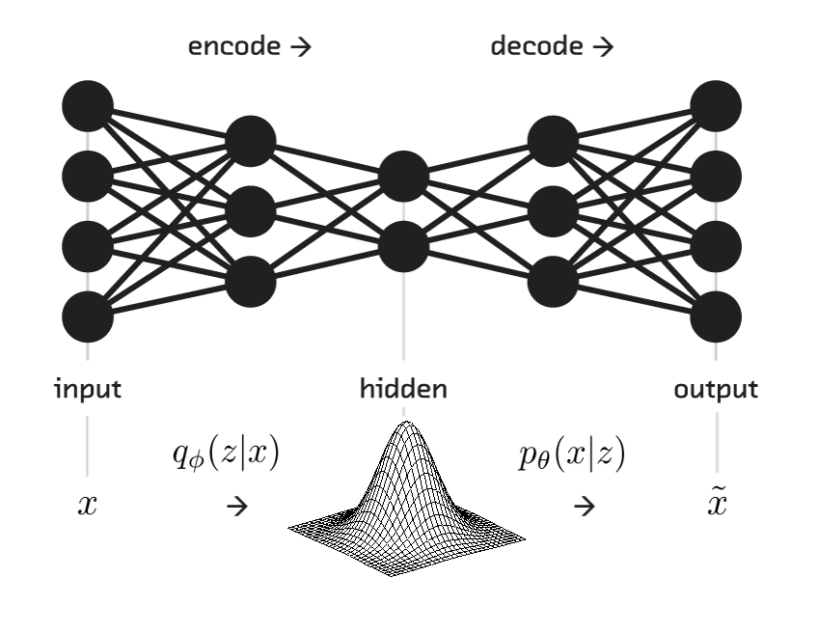
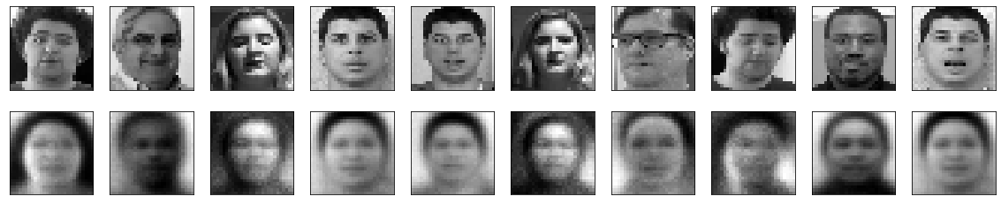
3. BimodalEncoder - learning latent space distribution
(Inspiration - Autoencoder latent space distribution)
Learn latent space distribution for real and fake samples
Use the z-score on test data for predictions
Accuracy : 0.94
F1: 0.85
Notes:
Two encoders, one for real and one for fake.
Once we have those, take a sample, find its latent space distribution, guess if its fake or real.
Performance was around 85-85%

Slide 11
4. Discussion and insight
Approach | Accuracy | F1 | Parameters
Baseline | 0.63 | 0.6 | 23M
Stochastic gradient | 0.57 | 0.57 | 17k
Adaboost | 0.57 | 0.56 | 31k
Gradient Boosting | 0.59 | 0.61 | 185k
Facial Gradient CNN | 0.95 | 0.87 | 56,000
Autoencoder learning | 0.94 | 0.85 | 150 dim latent space
Deepfake detection is a challenging problem to solve.
Sampling is important. Having the same number of real and fake images influenced the accuracy.
Preprocessing is influential, as it influenced the accuracy and F1 scores a lot.
Starting small with basic machine learning gave us insight into the features and scale up into deeper techniques.
Deep learning is better than regular machine learning for deepfakes. Too deep is worse than mindful deep (InceptionNet vs Facial Gradient)
Processing large amounts of data can lead to memory issues - we were only using images, whole videos would have lead to even more issues.
Notes:
The scaling up gave us experience and insight in how to approach machine learning projects in the future.

Slide 12
References
https://www.kaggle.com/unkownhihi/deepfake/kernels
https://www.kaggle.com/rutujajadhavj/kernel30813a6c19/

